Slide 1
人機介面
Arduino + Android
授課教師:
開課單位:

Slide 2
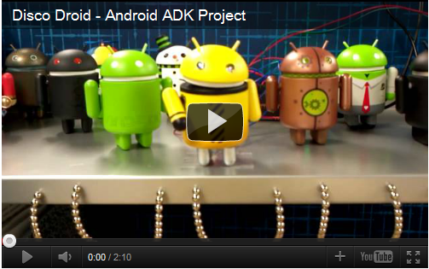
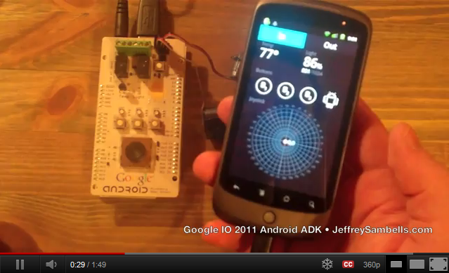
Arduino + Android 應用
Arduino:簡單易用的開放源碼電子原型平台（electronics prototyping platform）
Android: 相當受歡迎的行動裝置作業系統平台
兩者相遇，可以創造哪些可能的應用?

Slide 3
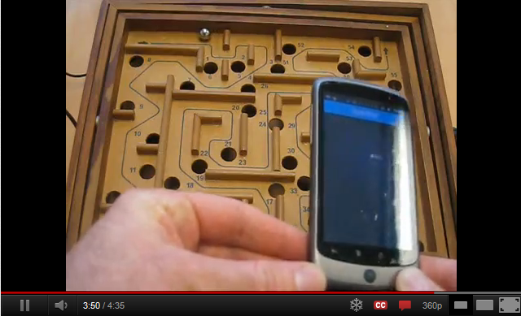

更多應用案例

Slide 4
溝通方案
使用 Android ADK: Android Open Accessory Development Kit
透過藍芽通訊作雙向溝通 Amarino: http://www.amarino-toolkit.net/
Build your own solution:
  http://jdesbonnet.blogspot.com/2011/05/arduino-to-android-io-on-cheap-aka-poor.html
  Arduino + Android Projects for the evil genius

Slide 5
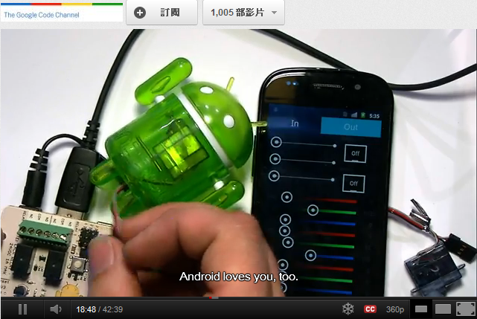
Google I/O 2011 Video
Introducing Android Open Accessory API and Development Kit (ADK)

Slide 6
ADK 相容開發板
The Arduino Store provides the Arduino Mega ADK (in EU nations or non-EU nations) that is based on the ATmega2560 and supports the ADK firmware.
DIY Drones provides an Arduino-compatible board geared towards RC (radio controlled) and UAV (unmanned aerial vehicle) enthusiasts.
mbed provides a microcontroller and a library to develop accessories that support the Android accessory protocol. For more information, see mbed with the Android ADK.
Microchip provides a PIC based USB microcontroller board.
Modern Device provides an Arduino-compatible board that supports the ADK firmware.
RT Corp provides an Arduino-compatible board based on the Android ADK board design.
Seeed Studio provides an Arduino-compatible board that supports the ADK firmware.
SparkFun's IOIO board now has beta support for the ADK firmware.

Slide 7
相關文件
Android developers 官方網站
Android 課程 (中文教學:關於ADK部分)

Slide 8
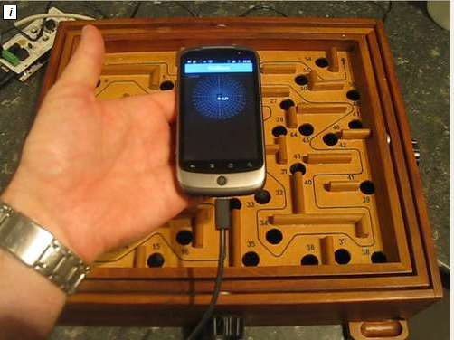
完整案例說明:
DIY Android Ball Maze
http://www.instructables.com/id/DIY-Android-Ball-Maze-An-Introduction-to-the-And/?ALLSTEPS

Slide 9
Amarino
Amarino是MIT High-Low Tech小組的專案，取意Android meets Arduino，功能與Android-Firmata相同，但採用更簡單的協定。Amarino 協定封包格式非常單純，只是把要傳輸的資料夾在一個 0×12 起始符號和 0×13 確認符號中間而已。
要開發 Amarino 的互動應用，Arduino 這端的程式要用 MeetAndroid 函式庫，而 Android 這端的程式則要使用 AmarinoLibrary.jar 函式庫，這兩個函式庫都可以在 Amarino 官網取得。

Slide 10
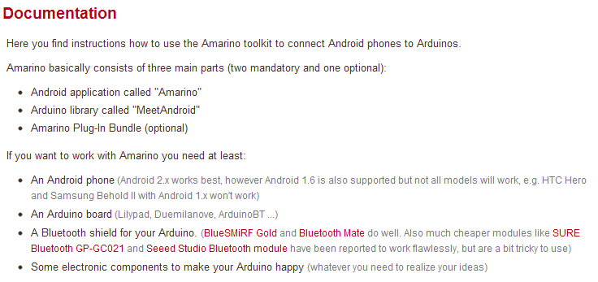
Amarino Documentation

Slide 11
Amarino Presentation
Amarino: a toolkit for the rapid prototyping of mobile ubiquitous computing
Master Thesis

Slide 12
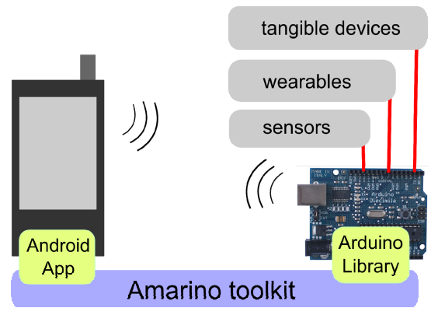

示意圖
Amarino
MeetAndroid
Notes:
取自 http://140.129.19.123/slides/CHWei_20110801.ppt

Slide 13
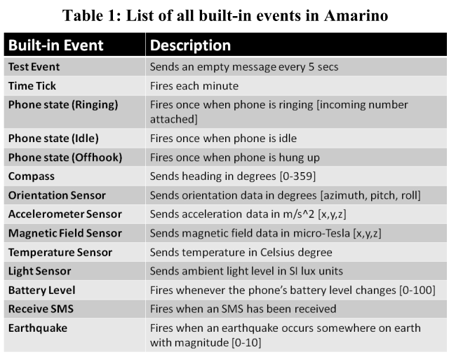
Amarino 函式庫內建 Event
Notes:
取自 http://140.129.19.123/slides/CHWei_20110801.ppt

Slide 14
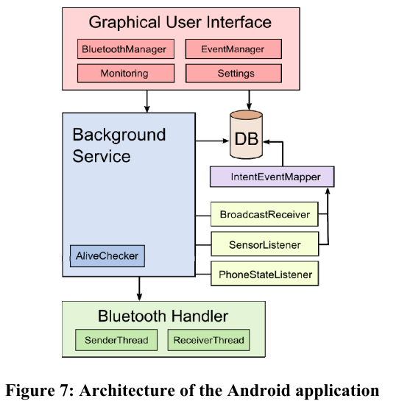
架構
Notes:
取自 http://140.129.19.123/slides/CHWei_20110801.ppt

Slide 15
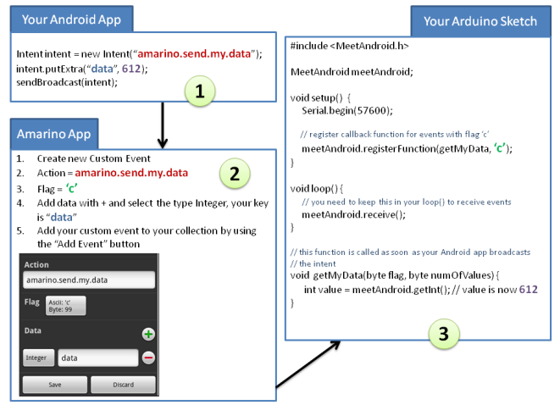
Android與 Arduino 間資料傳輸

Slide 16
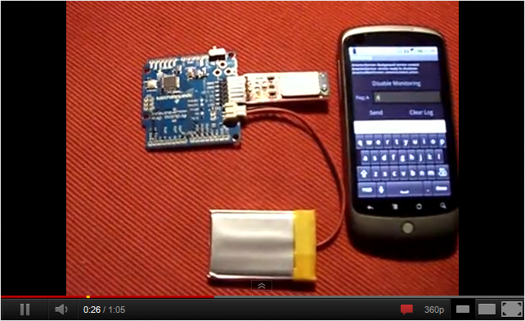
Amarino Example

Slide 17
Arduino + Android Projects
Book site: http://www.duinodroid.com/home

